Slide 1
Neurophysiological approach to rehabilitation after full-face transplants
Çağdaş Topçu^{1,2}
¹Multimedia Systems Department, Faculty of Electronics, Telecommunication and Informatics, Gdansk Univ. of Technology, Gdansk, Poland
²Mayo Clinic, Department of Neurology, Rochester MN, USA

Slide 2
Conflict of interest disclosure
I have no, real or perceived, direct or indirect conflicts of interest that relate to this presentation.
The ECCN 2019 Congress is accredited for CME credits by EACCME-UEMS and invited speakers and oral presenters are required to disclose their potential conflict of interest going back 3 years prior to this presentation. The intent of this disclosure is not to prevent a speaker with a conflict of interest (any significant financial relationship a speaker has with manufacturers or providers of any commercial products or services relevant to the talk) from making a presentation, but rather to provide listeners with information on which they can make their own judgment. It remains for audience members to determine whether the speaker’s interests or relationships may influence the presentation. Drug or device advertisement is strictly forbidden.

Slide 3
Outline
Individualized Rehabilitation
Detecting muscle activities
Wavelet packet energy
Hilbert transform amplitude
Time-frequency spectrum
Assessing the recovery with a complexity measure
Fuzzy entropy
HD-sEMG
Conclusions

Slide 4
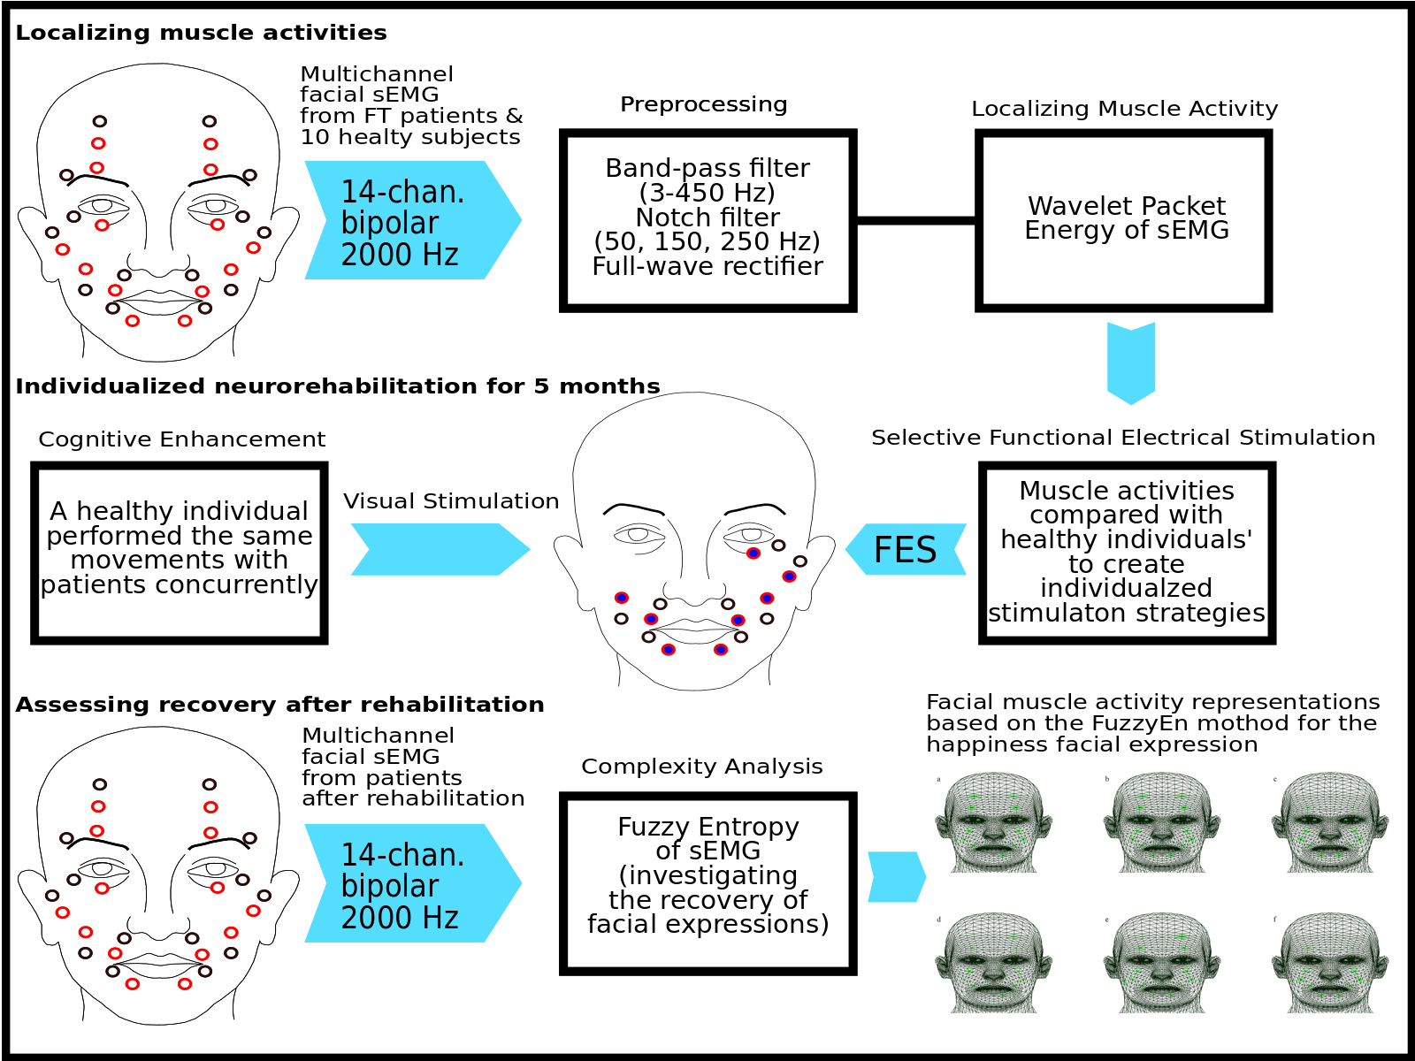

Slide 5
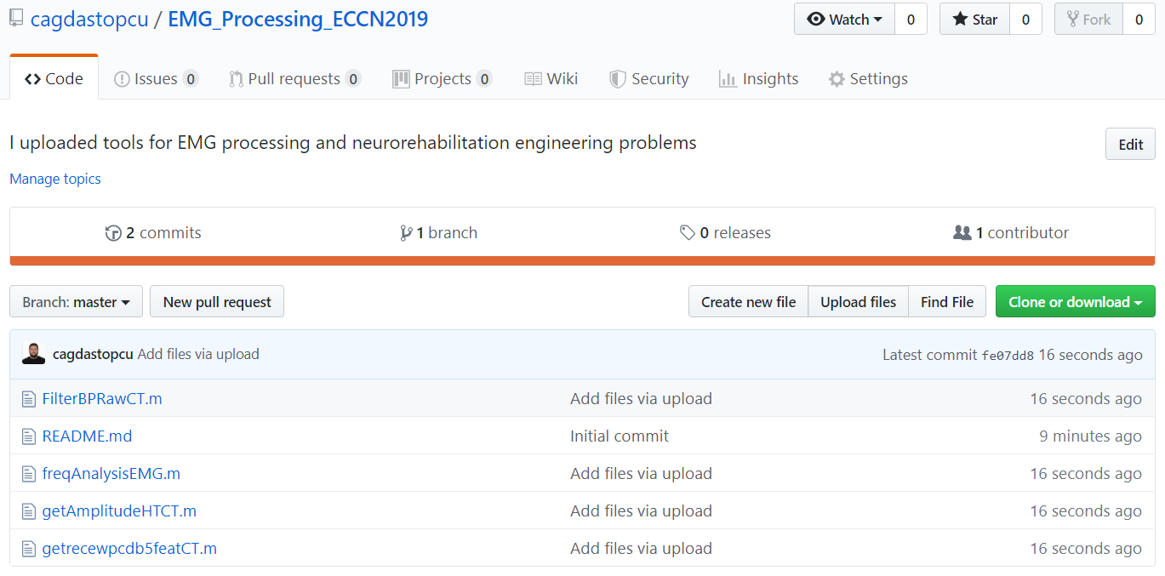
Codes and slides:
github.com/cagdastopcu/EMG_Processing_ECCN2019

Slide 6
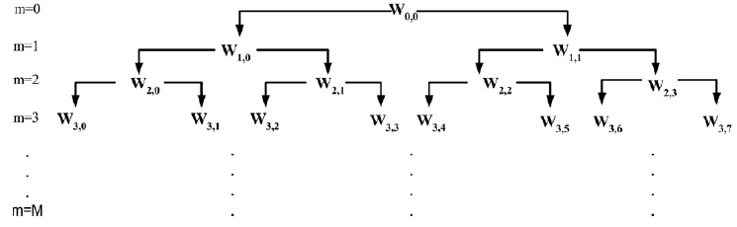
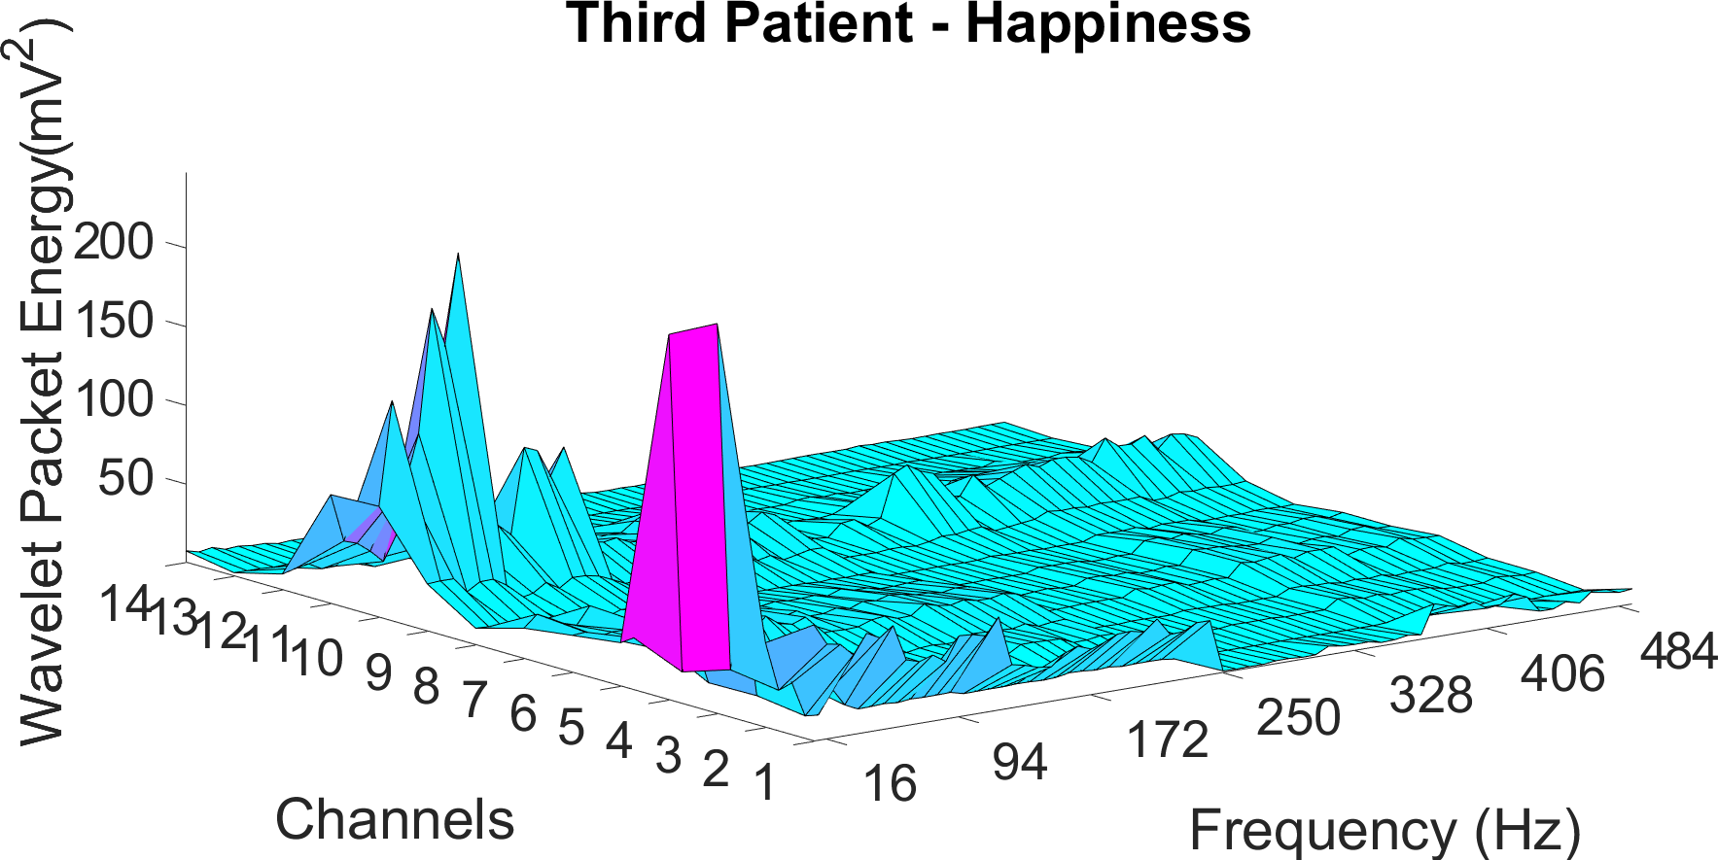
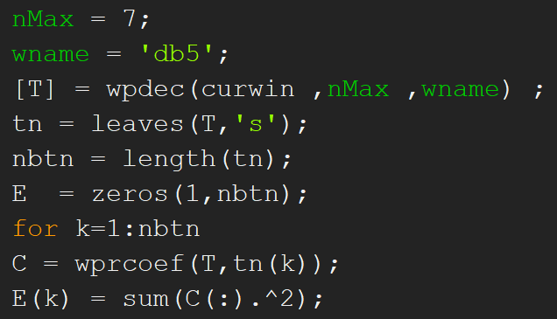
Wavelet Packet Energy
getrecewpcdb5featCT.m

Slide 7
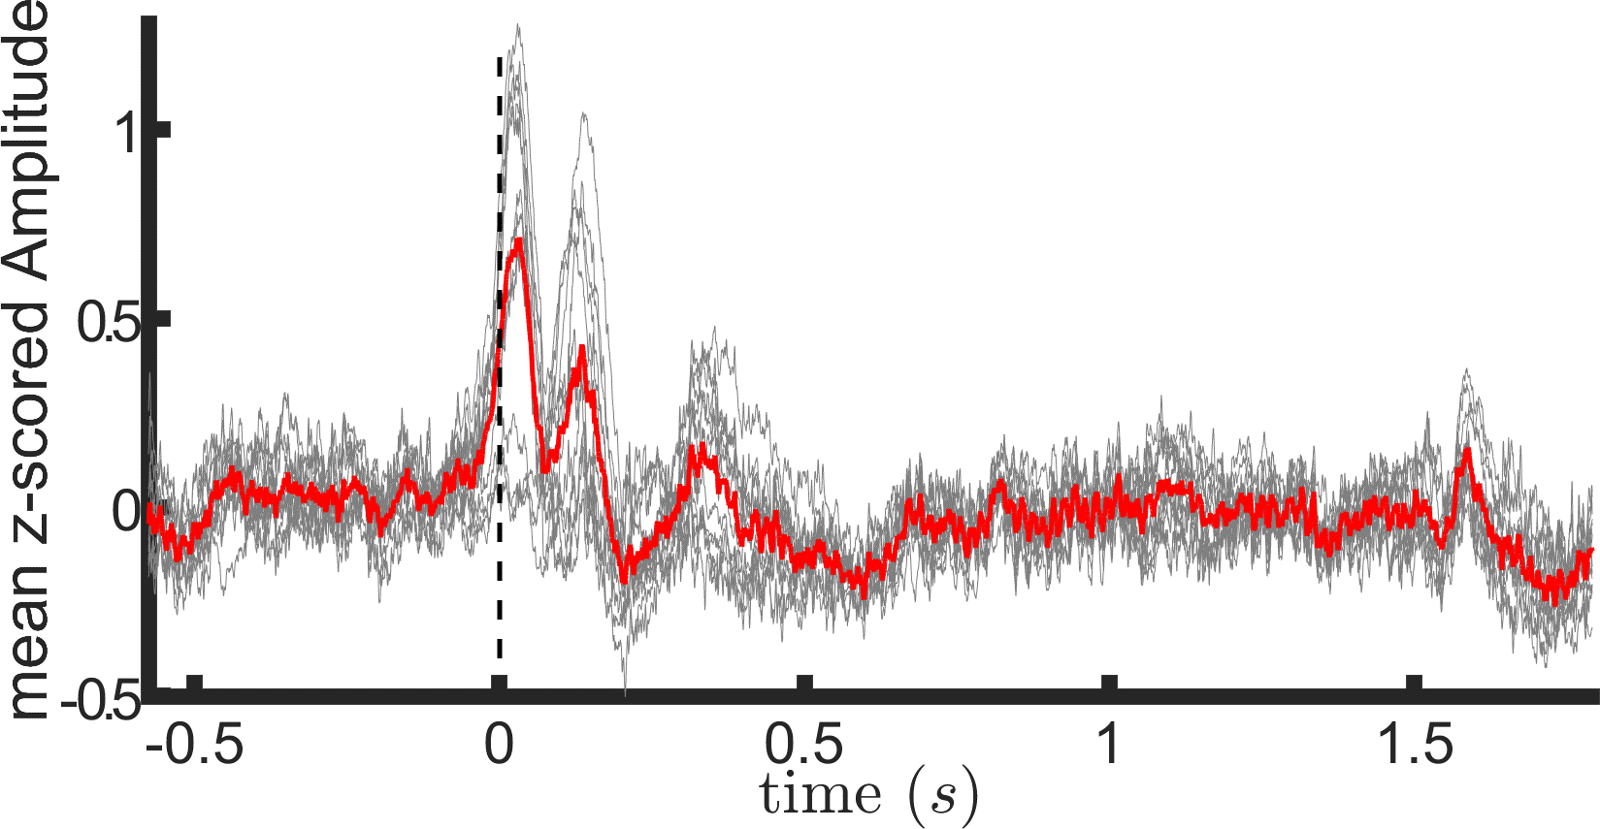
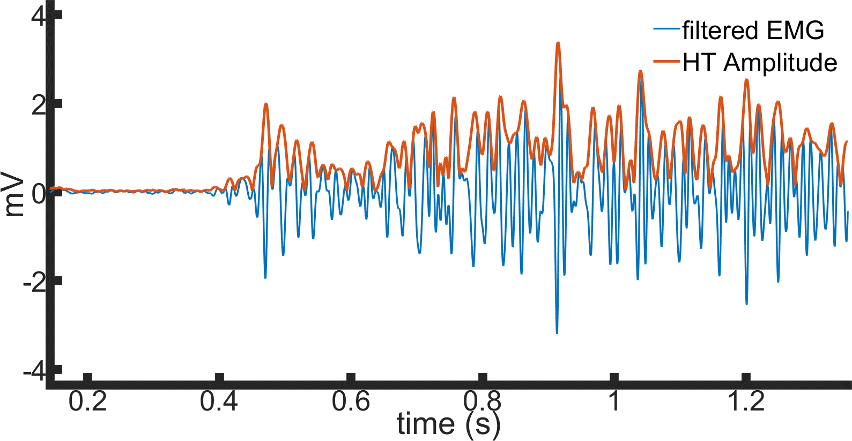
Hilbert Transform Amplitude
Envelope of iEEG during
a cognitive task
high gamma (70-110 Hz)
getAmplitudeHTCT.m

Slide 8
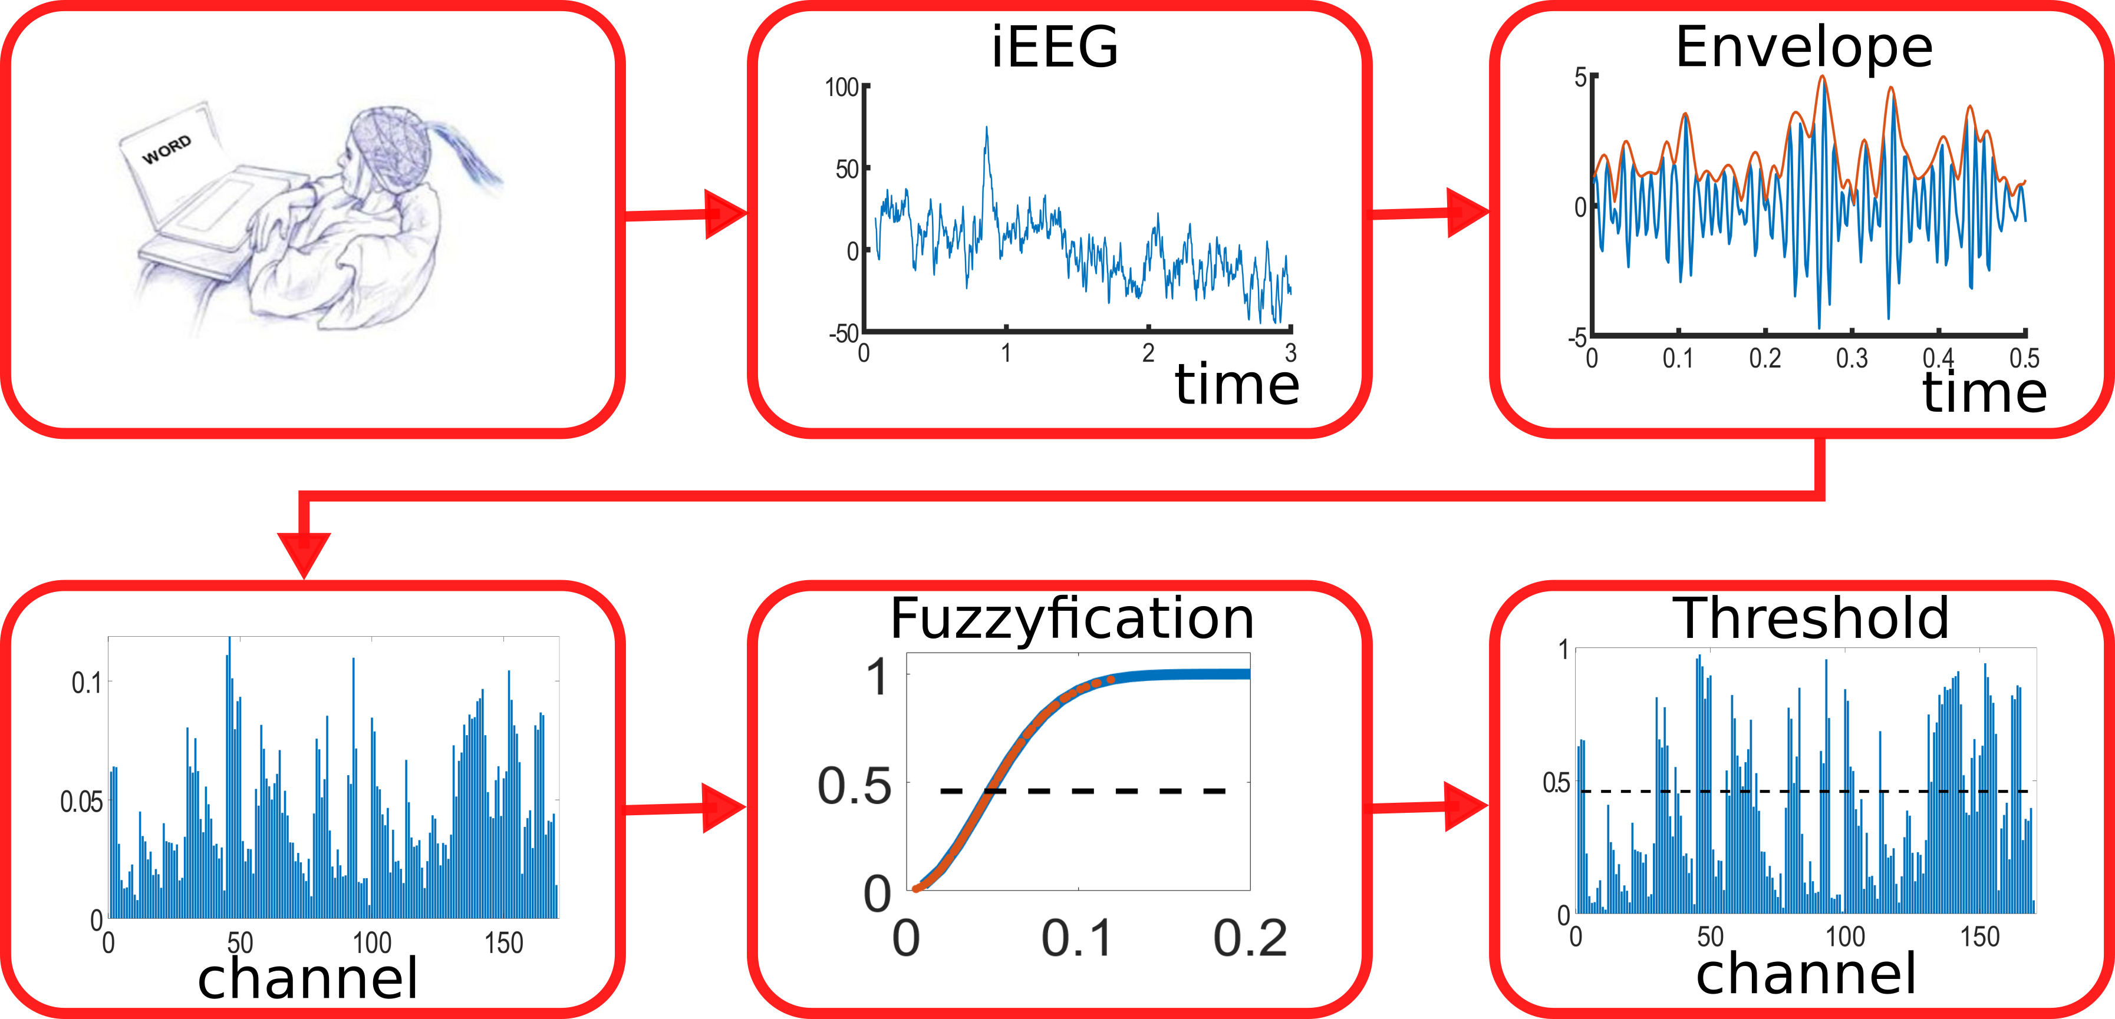

Slide 9
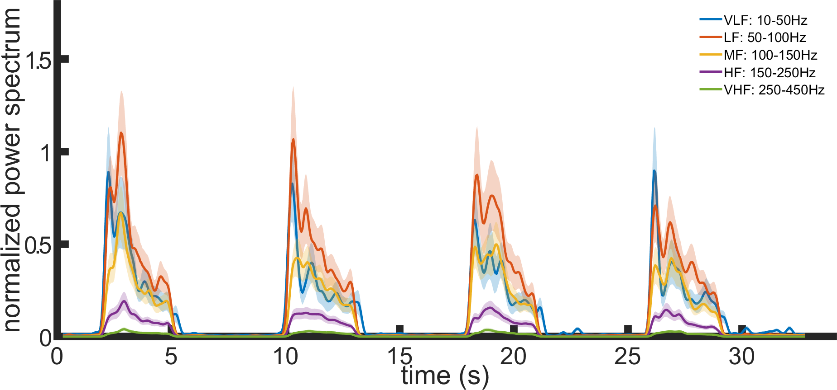
Multi-taper time-frequency spectrum
mtspecgramc() function
from the Chronux toolbox
http://chronux.org/
Sample usage >>
freqAnalysisEMG.m

Slide 10
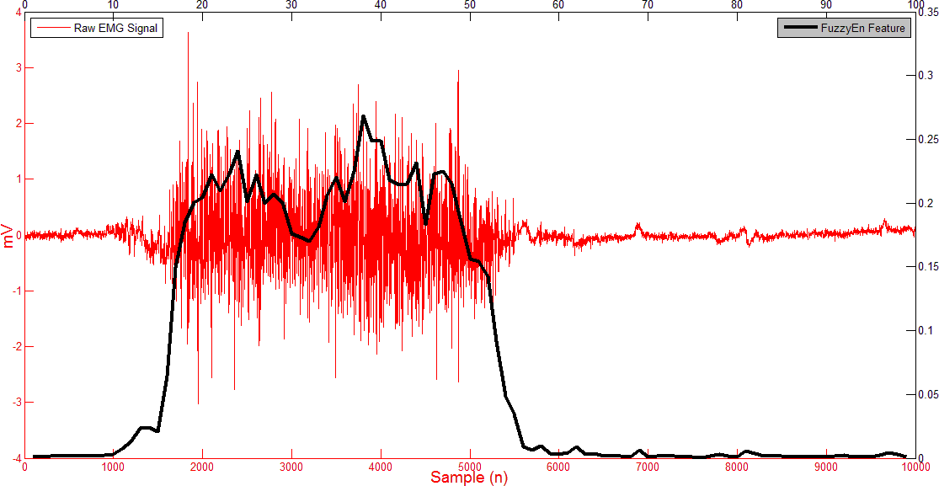
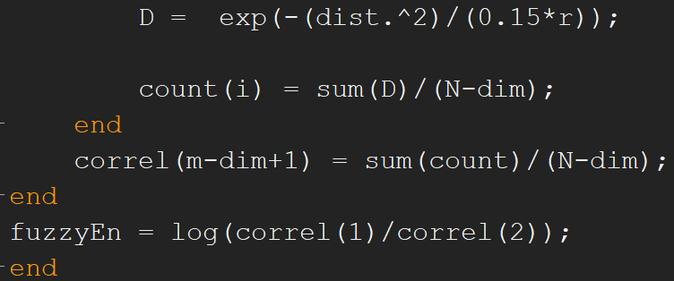
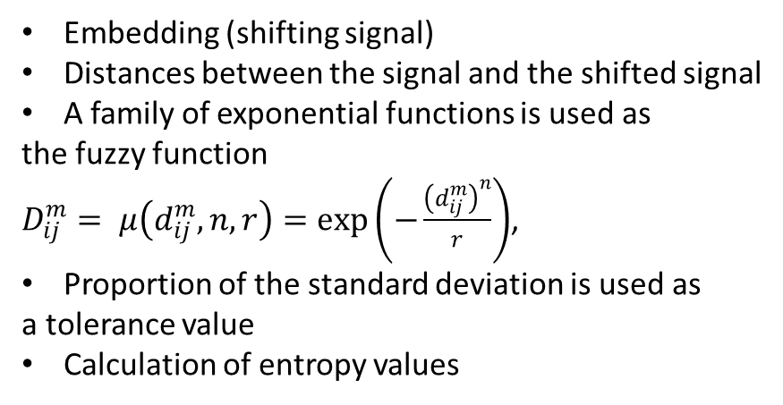
Fuzzy Entropy (FuzzyEn)
Embedding (shifting signal)
Distances between the signal and the shifted signal
A family of exponential functions is used as
the fuzzy function
$D_{ij}^{m}= μ\left(d_{ij}^{m},n,r\right)=\exp\left(−\frac{{\left(d_{ij}^{m}\right)}^{n}}{r}\right)$,
Proportion of the standard deviation is used as
a tolerance value
Calculation of entropy values
FuzzyEn.m

Slide 11
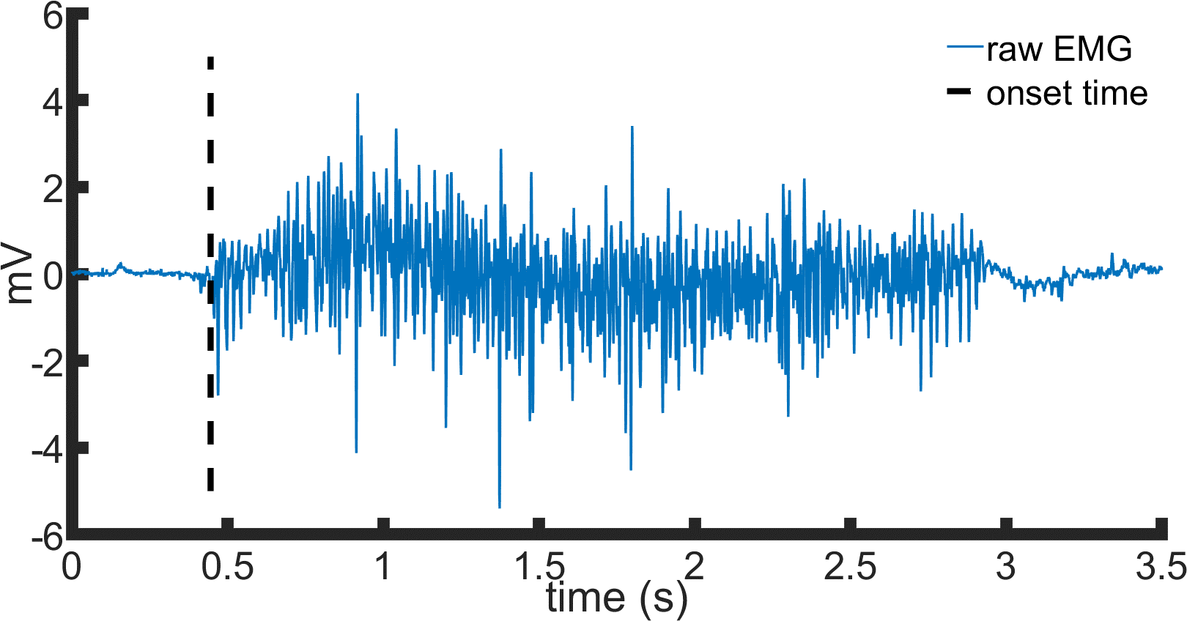
Onset detection - FuzzyEn
getOnsetTime.m

Slide 12
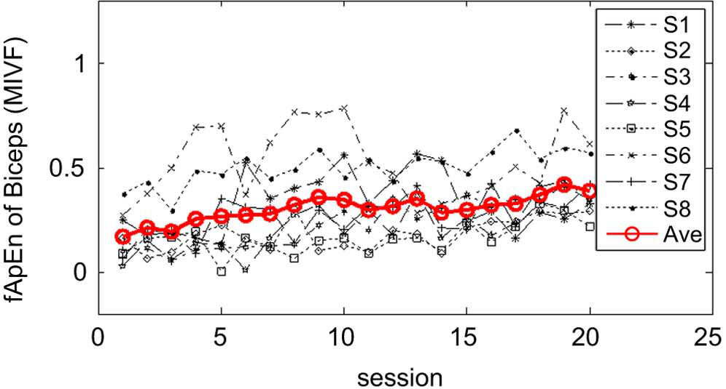
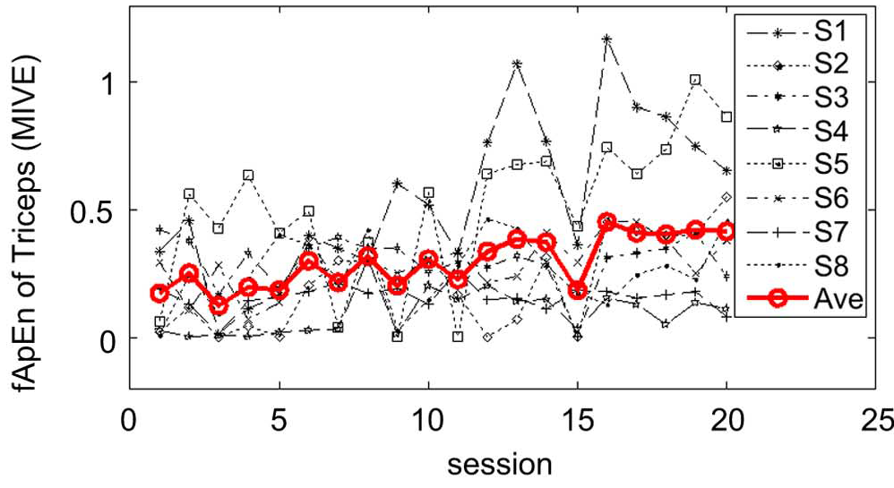
Fuzzy entropy and recovery: 25 robot-aided rehabilitation session in 8 stroke survivors
Sun, R., Song, R., & Tong, K. Y. (2014). Complexity analysis of EMG signals for patients after stroke during robot-aided rehabilitation training using fuzzy approximate entropy. Neural Systems and Rehabilitation Engineering, IEEE Transactions on, 22(5), 1013-1019.

Slide 13
Happiness facial expression
Before rehabilitation
After rehabilitation
Healthy cases n=10
Healthy
Case 1
Healthy
Case 2
Notes:
Loss of symmetry and synkinesis

Slide 14
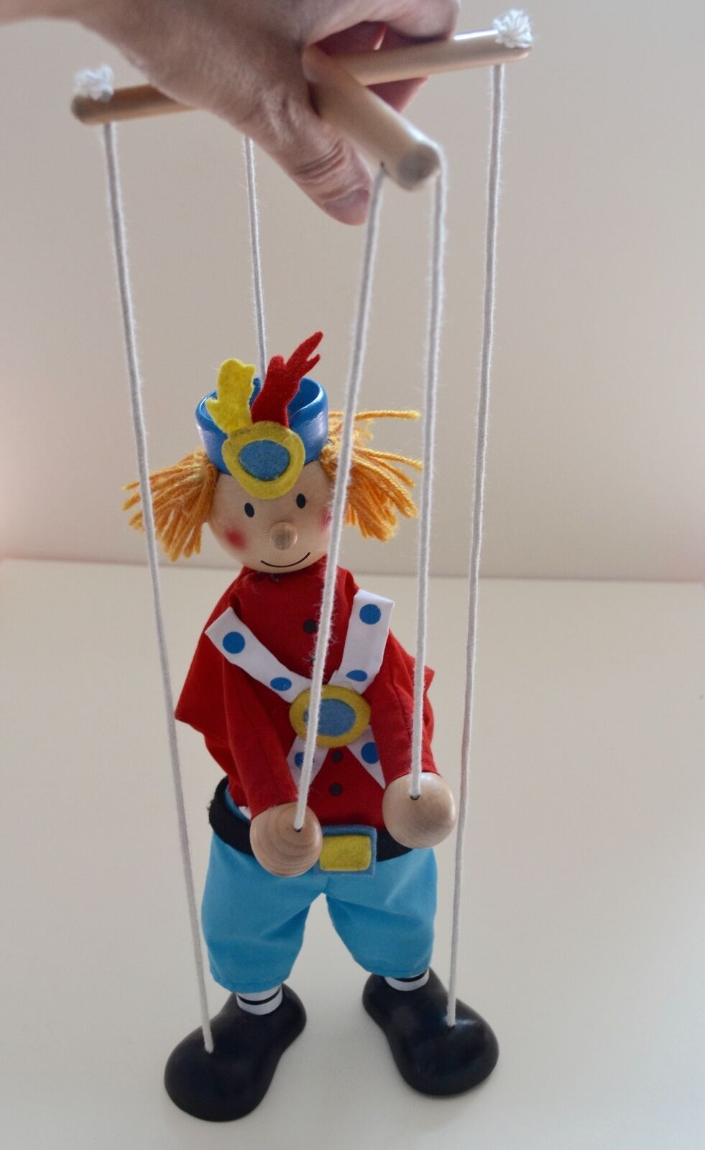
Muscle Synergies - Happiness
C
H
A
N
N
E
L
Healthy subjects n=5
FT
C
O
N
T
R
O
L

Slide 15
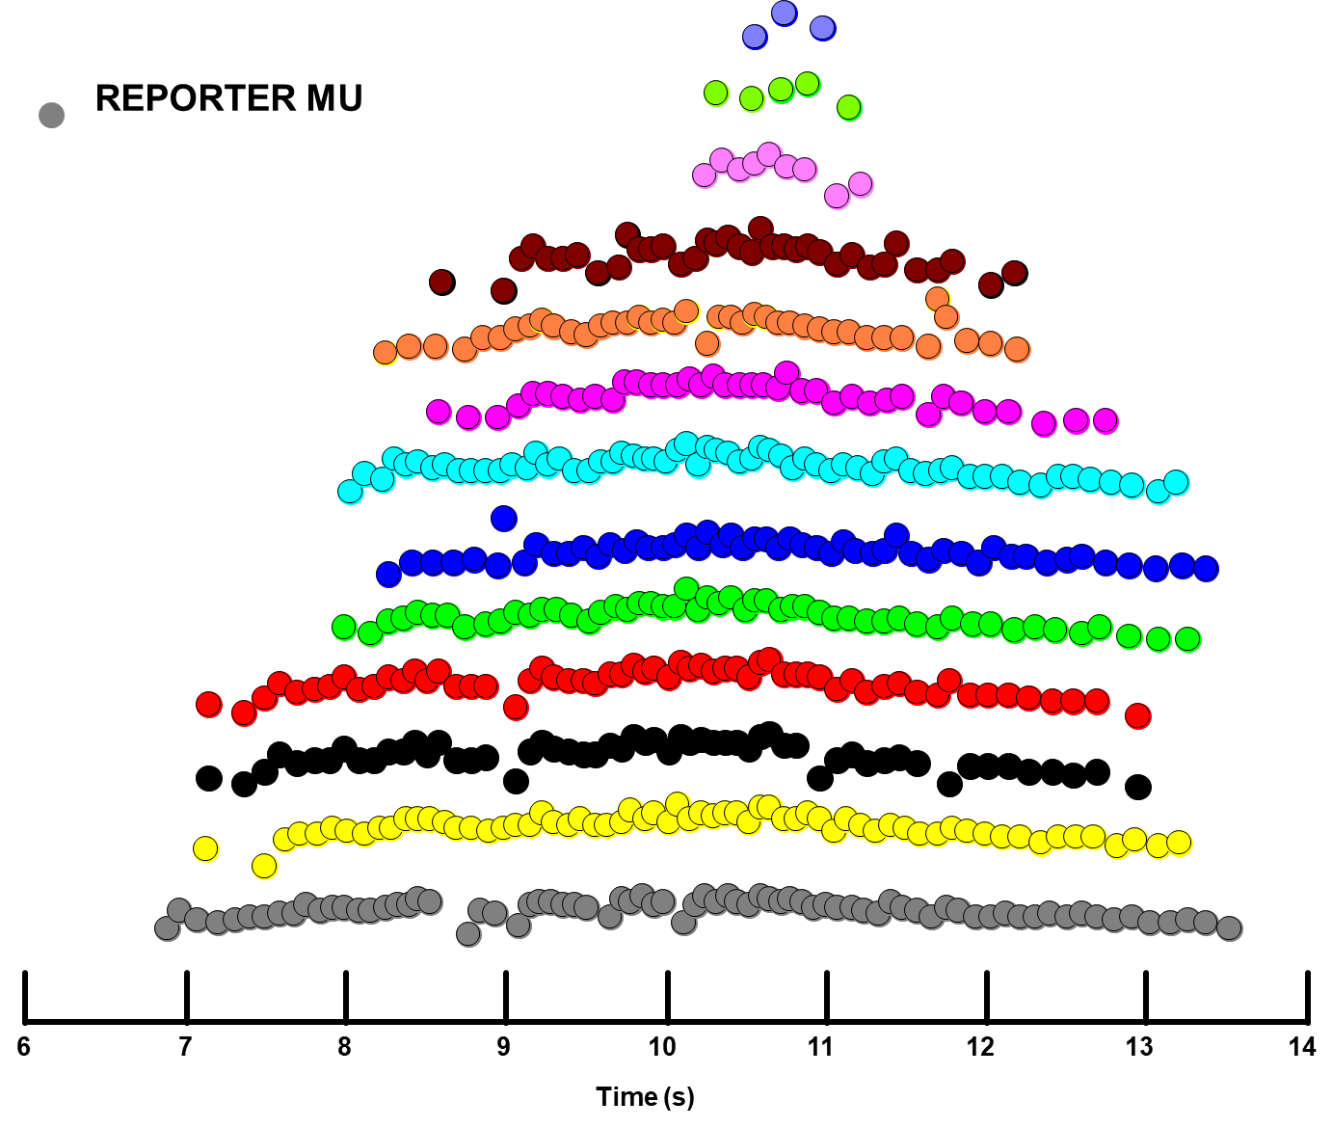
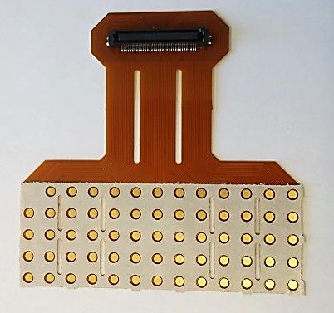
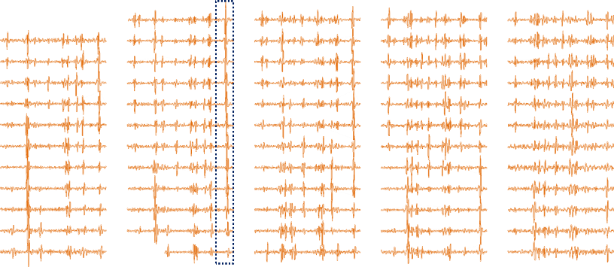
Identifying single MUs from HDsEMG
MU discharge trains
High-density surface EMG
Blind source separation
6
8
10
12
14
High Density EMG recordings provide the possibility to:
Use Multi-Channel Decomposition Algorithms (BSS)
Resolve Superimpositions at high activation levels and with high synchronization
Concurrent Recordings of Superficial and Deep Motor Units
Stable Waveform Characteristics
Identify the Same Motor Unit across different trials
Study Peripheral Properties
Innervation Zones, Conduction Velocity, Muscle Geometry
Notes:
FURTHERMORE… our next step is assessing the reinnervation after surgery at motor neuron level.
In HDsEMG, 64 monopolar EMG channel gives sufficient sparsity to decompose single motor unit action potentials from surface EMG using blind source separation algorithm.
Additionally the broader volume conductance of surface EMG enables identifying larger sample from actual population.

Slide 16
Conclusion
We developed an individualized rehabilitation method with selective stimulation
Stimulation parameters were fixed. Different stimulation parameters and muscle responses to them can be modelled as an optimization problem.
We should take account of possible problems during reinnervation processes to improve our rehabilitation methods
Lack of appropriate muscle activity, synkinesis, and aberrant reinnervation.
We should define functions. Recovery of functions needs reinnervation but reinnervation ≠ functions.
An atlas of functional movements with their classifications, accuracy and performance tests is a need to assess recovery of FT patients.

